Slide 1

Operating Systems BCS303
Balaji Vijaykumar B.E.,(NIE), M.Tech.,(SJCE)
Assistant Professor, Department of CS&E-AIML
The National Institute of Engineering, Mysuru
(Former Research & Development Engineer @ Philips R&D)
(Former Software Engineer @ Accenture)

Slide 2

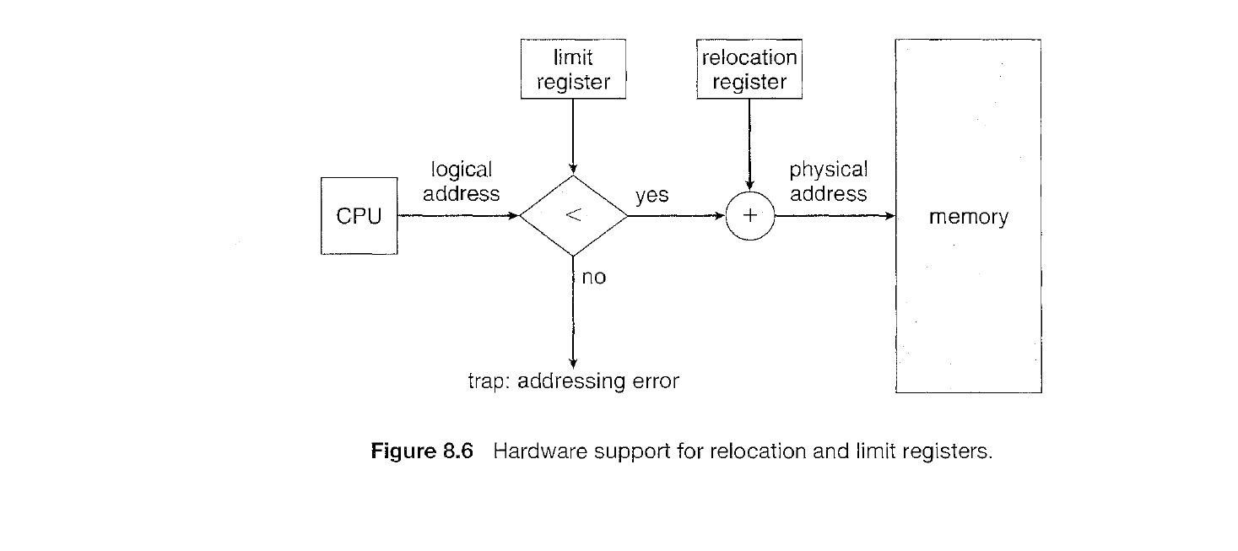

Slide 3
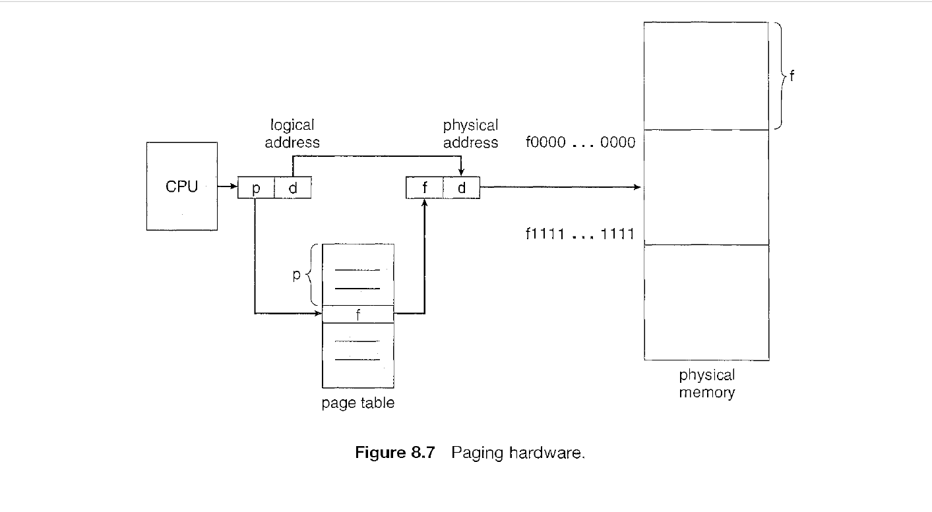
Paging

Slide 4
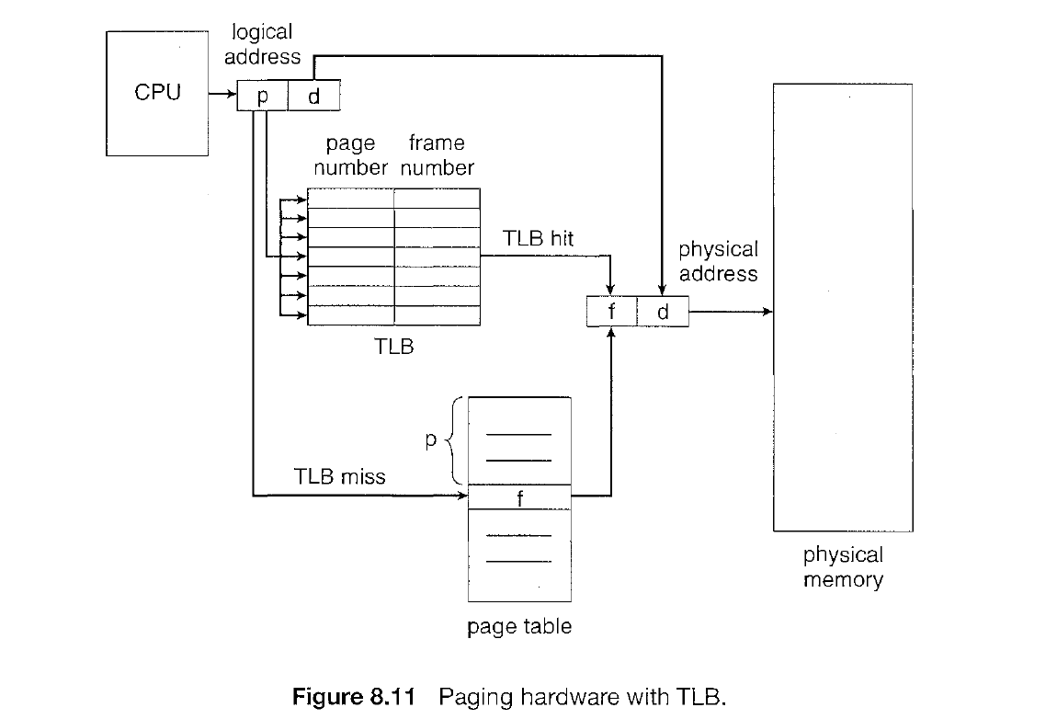
Paging with TLB

Slide 5
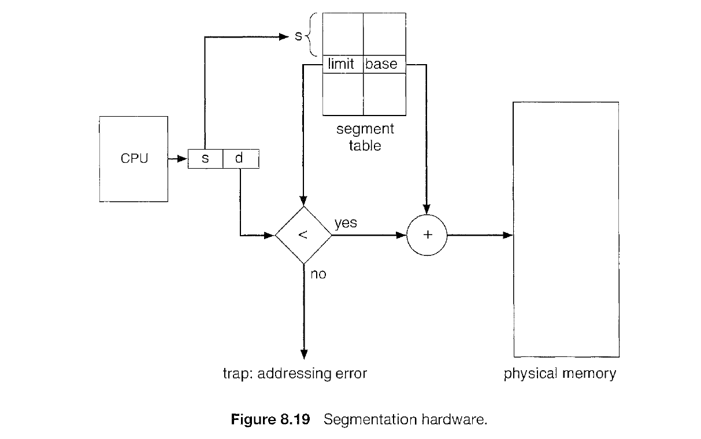
Segmentation

